Slide 1

Python Dictionary
COMP 6502 + COMP 6056
By Ida Bagus Kerthyayana Manuaba
Friday, 16 Oct 2020

Slide 2
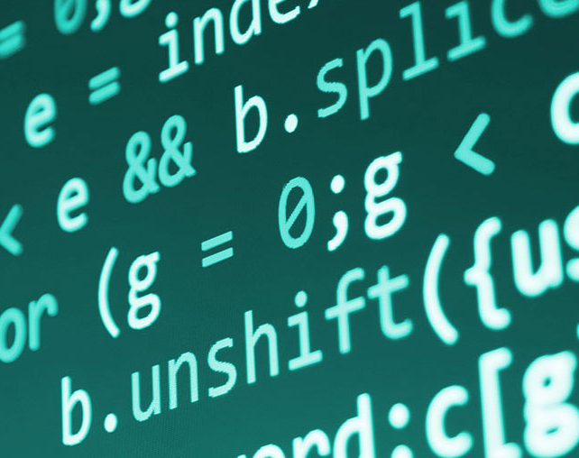
Agenda
Review:
Set
Python Dictionary

Slide 3
Learning Outcome
COMP 6502 - I2P:
Apply principles of Python programming in designing and developing a program
Translate a specified algorithm into correct self-documented Python code using generally accepted programming style.
Identify programming errors and solution requirements toward the problem
COMP 6506 - PDM:
Explain the basic principles of computing and programming
Design algorithmic solutions to problems.

Slide 4
Session Outcomes
Learn about dictionary including manipulation, built-in method and function
write simple code and example for dictionary

Slide 5
Review:
Set

Slide 6
Set
Anyone?

Slide 7
Python Dictionary

Slide 8
Python Dictionary
Python dictionary is an unordered collection of items. Each item of a dictionary has a key/value pair.
Dictionaries are optimized to retrieve values when the key is known.

Slide 9
Creating Python Dictionary
Creating a dictionary is as simple as placing items inside curly braces {} separated by commas.
An item has a key and a corresponding value that is expressed as a pair (key: value).
While the values can be of any data type and can repeat, keys must be of immutable type (string, number or tuple with immutable elements) and must be unique.

Slide 10
# empty dictionary
my_dict = {}
# dictionary with integer keys
my_dict = {1: 'apple', 2: 'ball’}
# dictionary with mixed keys
my_dict = {'name': 'John', 1: [2, 4, 3]}
# using dict()
my_dict = dict({1:'apple', 2:'ball’})
# from sequence having each item as a pair
my_dict = dict([(1,'apple'), (2,'ball')])
As you can see from above, we can also create a dictionary using the built-in dict() function.

Slide 11
Accessing Elements from Dictionary
While indexing is used with other data types to access values, a dictionary uses keys.
Keys can be used either inside square brackets [] or with the get() method.
If we use the square brackets [], KeyError is raised in case a key is not found in the dictionary.
On the other hand, the get() method returns None if the key is not found.

Slide 12
# get vs [] for retrieving elements
my_dict = {'name': 'Jack', 'age': 26}
# Output: Jack
print(my_dict['name’])
# Output: 26
print(my_dict.get('age’))
# Trying to access keys which doesn't exist throws error
# Output None
print(my_dict.get('address’))
# KeyError
print(my_dict['address'])

Slide 13
Changing and Adding Dictionary elements
Dictionaries are mutable.
We can add new items or change the value of existing items using an assignment operator.
If the key is already present, then the existing value gets updated.
In case the key is not present, a new (key: value) pair is added to the dictionary.

Slide 14
# Changing and adding Dictionary Elements
my_dict = {'name': 'Jack', 'age': 26}
# update value
my_dict['age'] = 27
#Output: {'age': 27, 'name': 'Jack’}
print(my_dict)
# add item
my_dict['address'] = 'Downtown’
# Output: {'address': 'Downtown', 'age': 27, 'name': 'Jack'} print(my_dict)

Slide 15
Removing elements from Dictionary
We can remove a particular item in a dictionary by using the pop() method. This method removes an item with the provided key and returns the value.
The popitem() method can be used to remove and return an arbitrary (key, value) item pair from the dictionary. All the items can be removed at once, using the clear() method.
We can also use the del keyword to remove individual items or the entire dictionary itself.

Slide 16
# Removing elements from a dictionary
# create a dictionary
squares = {1: 1, 2: 4, 3: 9, 4: 16, 5: 25}
# remove a particular item, returns its value
# Output: 16
print(squares.pop(4))
# Output: {1: 1, 2: 4, 3: 9, 5: 25}
print(squares)
# remove an arbitrary item, return (key,value)
# Output: (5, 25)
print(squares.popitem())
# Output: {1: 1, 2: 4, 3: 9}
print(squares)
# remove all items
squares.clear()
# Output: {}
print(squares)
# delete the dictionary itself
del squares
# Throws Error
print(squares)

Slide 17
Python Dictionary Methods
Methods that are available with a dictionary are tabulated below. Some of them have already been used in the above examples.
Method | Description
clear() | Removes all items from the dictionary.
copy() | Returns a shallow copy of the dictionary.
fromkeys(seq[, v]) | Returns a new dictionary with keys from seq and value equal to v (defaults to None).
get(key[,d]) | Returns the value of the key. If the key does not exist, returns d (defaults to None).
items() | Return a new object of the dictionary's items in (key, value) format.
keys() | Returns a new object of the dictionary's keys.
pop(key[,d]) | Removes the item with the key and returns its value or d if key is not found. If d is not provided and the key is not found, it raises KeyError.
popitem() | Removes and returns an arbitrary item (key, value). Raises KeyError if the dictionary is empty.
setdefault(key[,d]) | Returns the corresponding value if the key is in the dictionary. If not, inserts the key with a value of d and returns d (defaults to None).
update([other]) | Updates the dictionary with the key/value pairs from other, overwriting existing keys.
values() | Returns a new object of the dictionary's values

Slide 18
# Dictionary Methods
marks = {}.fromkeys(['Math', 'English', 'Science'], 0)
# Output: {'English': 0, 'Math': 0, 'Science': 0}
print(marks)
for item in marks.items():
print(item)
# Output: ['English', 'Math', 'Science’]
print(list(sorted(marks.keys())))

Slide 19
Python Dictionary Comprehension
Dictionary comprehension is an elegant and concise way to create a new dictionary from an iterable in Python.
Dictionary comprehension consists of an expression pair (key: value) followed by a for statement inside curly braces {}.
Here is an example to make a dictionary with each item being a pair of a number and its square.
# Dictionary Comprehension
squares = {x: x*x for x in range(6)}
print(squares)

Slide 20
That code is equivalent to
squares = {}
for x in range(6):
squares[x] = x*x
print(squares)
A dictionary comprehension can optionally contain more for or if statements.
An optional if statement can filter out items to form the new dictionary.
Here are some examples to make a dictionary with only odd items.
# Dictionary Comprehension with if conditional
odd_squares = {x: x*x for x in range(11) if x % 2 == 1}
print(odd_squares)
To learn more dictionary comprehensions, visit
https://www.programiz.com/python-programming/dictionary-comprehension

Slide 21
Other Dictionary Operations
Dictionary Membership Test
We can test if a key is in a dictionary or not using the keyword in. Notice that the membership test is only for the keys and not for the values.
# Membership Test for Dictionary Keys
squares = {1: 1, 3: 9, 5: 25, 7: 49, 9: 81}
# Output: True
print(1 in squares)
# Output: True
print(2 not in squares)
# membership tests for key only not value
# Output: False
print(49 in squares)

Slide 22
Iterating Through a Dictionary
We can iterate through each key in a dictionary using a for loop.
# Iterating through a Dictionary
squares = {1: 1, 3: 9, 5: 25, 7: 49, 9: 81}
for i in squares:
print(squares[i])

Slide 23
Dictionary Built-in Functions
Built-in functions like all(), any(), len(), cmp(), sorted(), etc. are commonly used with dictionaries to perform different tasks.
Function | Description
all() | Return True if all keys of the dictionary are True (or if the dictionary is empty).
any() | Return True if any key of the dictionary is true. If the dictionary is empty, return False.
len() | Return the length (the number of items) in the dictionary.
cmp() | Compares items of two dictionaries. (Not available in Python 3)
sorted() | Return a new sorted list of keys in the dictionary.

Slide 24
Here are some examples that use built-in functions to work with a dictionary.
# Dictionary Built-in Functions
squares = {0: 0, 1: 1, 3: 9, 5: 25, 7: 49, 9: 81}
# Output: False
print(all(squares))
# Output: True
print(any(squares))
# Output: 6
print(len(squares))
# Output: [0, 1, 3, 5, 7, 9]
print(sorted(squares))

Slide 25
So what we have learnt today?
Anyone?

Slide 26
More References
https://www.w3schools.com/python/python_dictionaries.asp
https://www.programiz.com/python-programming/dictionary
https://www.tutorialspoint.com/python/python_dictionary.htm
https://www.guru99.com/python-dictionary-beginners-tutorial.html

Slide 27
Thank you

Slide 28
Still have Extra time?
Let’s continue to discuss the list exercise Part 1 and Part 2

